Slide 1
Health
Management
Organization

Slide 2
Project Goal
Provide actionable insight, based on the data available, as well as accurately predict which people (customers) will be expensive.
Understand the key drivers for why some people are more expensive (i.e., require more health care), as well as predict which people will be expensive (in terms of health care costs).
The dataset contains healthcare cost information from an HMO (Health Management Organization). Each row in the dataset represents a person.
Predict people who will spend a lot of money on health care next year (i.e., which people will have high healthcare costs).
Provide actionable insight to the HMO, in terms of how to lower their total health care costs, by providing a specific recommendation on how to lower health care costs.

Slide 3
Project Agenda
PHASE 1
PHASE 2
PHASE 3
PHASE 4
PHASE 5
Data cleaning
Explore the data
Overview the important variables
Data modeling and trends
Conclusion and recommendations

Slide 4
Data Cleaning
Import the original data into R studio (read.csv)
Check each variables – N/A, spelling errors….( which(is.na))
Then we find out there are two variables (bmi & hypertension) contain NA values
For the variable - bmi:
We use average value of others in bmi to replace the NA values - more accurate
For the variable - hypertension:
We use mode value of others in hypertension to replace the NA values
Unlike bmi, hypertension is a dummy variable
Original
After cleaning
Original
After cleaning

Slide 5
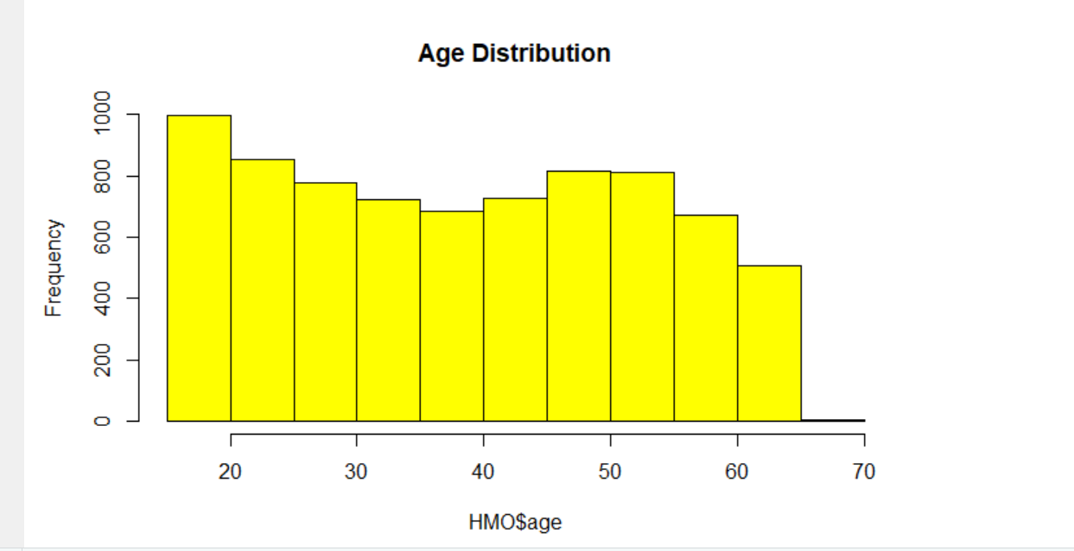
Exploratory Of Data - Histograms
1. Histograms and boxplots of numeric variables are typically useful. Producing tables of categorical response variables is often helpful.

Slide 6
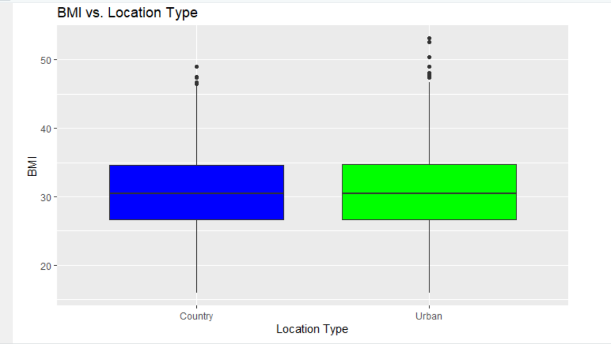
Exploratory Of Data - Boxplots

Slide 7
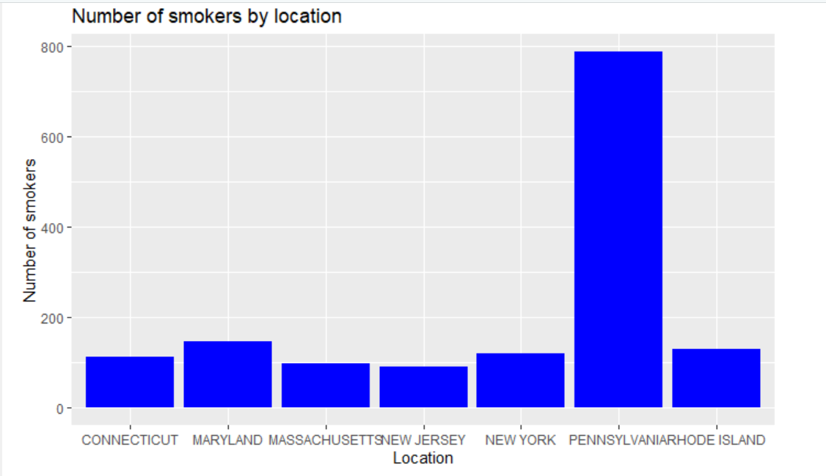
Exploratory Of Data – Bar Chart

Slide 8
Overview of Important Variables
Age : Age of the person will play major role in analysis here as Senior people have more health issues than young ones.
BMI : Body Mass Index defines person’s weight with respect to height. This is the one of the important factor to find how person is doing in health aspect.
Smoker : Smoking leads to many health issues hence it is important to know if the person is into smoking or not.
Exercise : Active exercise person has low chance of facing medical issues than not-active exercise person.

Slide 9
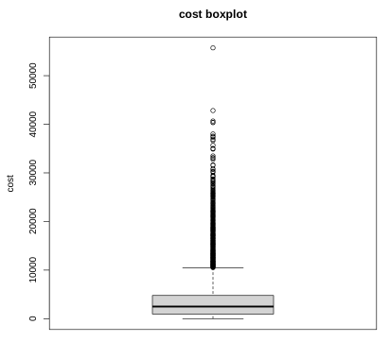
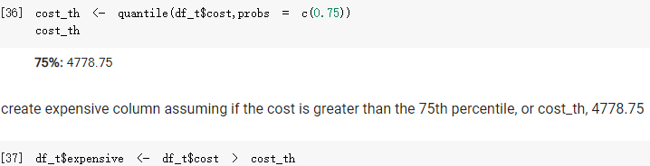
Data Modeling and Trends
Based on the fact that over 75th percentile, there is a very long tail in the box plot
We model expensive:
True, if the cost>= 75th percentile, or 4778.75
False, the other condition

Slide 10
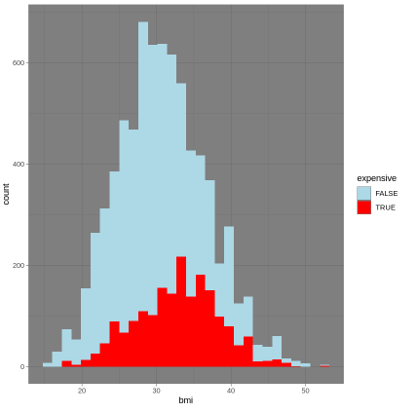
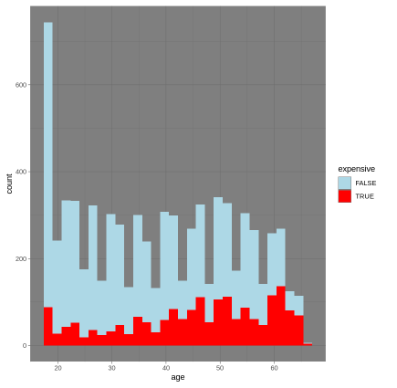
Histogram compare with expense
bmi
age

Slide 11
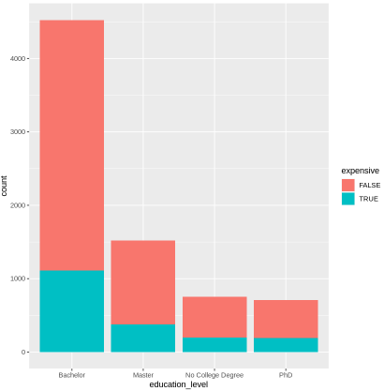
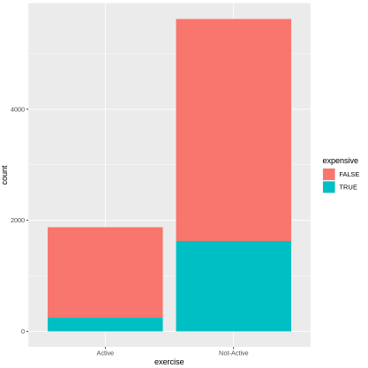
Histogram compare with expense
exercise
education level

Slide 12
Machine Learning Model 1, SVM
“Support Vector Machine” (SVM) is a supervised learning machine learning algorithm, mostly used in classification problems.
In this case, we feed all the input, build, and test the SVM classifier:
expensive TRUE OR FALSE
Model accuracy: 88.08%
Prediction accuracy: 86.68%
95% prediction accuracy CI: 84.85% to 88.36%

Slide 13
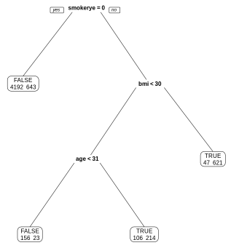
Machine Learning Model 2, CART
Classification And Regression Trees (CART) is another widely used Machine Learning model employee decision.
Model accuracy: 88.4%
Prediction accuracy: 86.07%
95% prediction accuracy CI: 84.21% to 87.78%

Slide 14
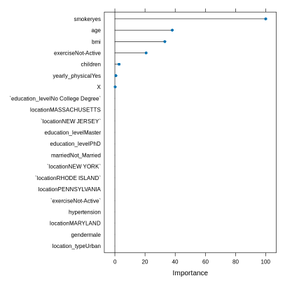
Machine Learning Model 2, CART Result
The interpretations of the decision tree can be found in the plot on the right
The following four factors contribute most to high expensive cost:
Active smoke
Senior people
High bmi
Non-active

Slide 15
Conclusion and Recommendations

